Slide 1

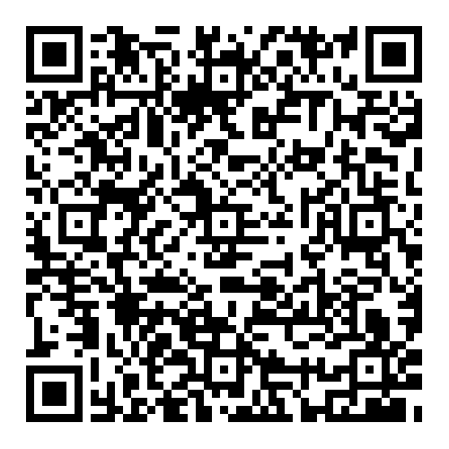
Queues
Demo Lesson
Dr. Michael Robbeloth
Target Course: Data Structures
April 8, 2025

Slide 2
ACM CS 2023 Coverage
Algorithms and Complexity (AL)
Fundamental Data Structures and Algorithms (CS Core: 24 hours, KA Core: 7 hours overall, one hour on queues) pg 18, 31-32
SDF/Fundamental Data Structures (12 core Tier-1 hours), pg. 305
Outcome: Know when to select a queue as an appropriate data structure for a given problem, pgs. 307-308
Outcome: Write programs that use a key abstract data type such as a queue, pgs 307-308

Slide 3
ABET Coverage
ABET CAC Criterion 2 & 6
Design, implement, and evaluate a computing-based solution to meet a given set of computing requirements in the context of the program’s discipline.
Apply computer science theory and software development fundamentals to produce computing-based solutions.
ABET EAC Criterion 1 & 7
an ability to identify, formulate, and solve complex engineering problems by applying principles of engineering, science, and mathematics
an ability to acquire and apply new knowledge as needed, using appropriate learning strategies

Slide 4
Today
Introduction to Queues
Queue Characteristics
Queue Operations
Types of Queues
Queue Implementation
Applications of Queues and Practical Examples
Quiz

Slide 5

Lines
“An Englishman, even if he is alone, forms an orderly queue of one.”
George Mikes (British Writer)

Slide 6
Where have you encountered a wait?

Slide 7

Hurry up and Wait.
Waiting to ride a roller coaster
Waiting at the ATM to make a withdrawal
Waiting in the security line at an airport*
Processing through immigration*

Slide 8
Hurry up and Wait.
You’ve been in a real-life implementation of a queue.
Today, we’ll focus on the virtual ones

Slide 9
So, what is a queue?
A collection of items that are placed into a structure in some order at one end
Removed from the structure at the other end
The entry point is called the tail/rear/back
The exit point is called the head/front
In theory, no storage limits (of course, applied computer scientists have to deal with resource limits)

Slide 10
Today
Introduction to Queues
Queue Characteristics
Queue Operations
Types of Queues
Queue Implementation
Applications of Queues and Practical Examples
Quiz

Slide 11
Queue Characteristics 1/2
A type of sequence (elements in a linear order)
First-in First-out (FIFO) data structure
The item at the front/rear of the queue has been there the longest/shortest
Search (Average/Worst) O(n)/O(n)
Insert/Delete O(1)/O(1) (if linked-list implementation; array is O(n))
Access O(n) (if linked-list implementation; array is O(1))
Space O(n)/O(n)

Slide 12
Queue Characteristics 2/2
For Java, it doesn’t handle null objects, indicating an empty queue (some implementations may not allow it)
Adding to a full/empty queue is overflow/underflow
Can be used in place of a tape in a Turing machine with two heads moving to the right
Semi-infinite work tape
The leading head is write-only
The right head is read only
Thus, FIFO storage
Can simulate a normal Turing machine (not true of pushdown stores or counters)

Slide 13
“How is a queue different from a stack?
FIFO vs LIFO
Stacks are better for undo operations, calculating expressions, and backtracking in algorithms
Interact at rear and front vs just at the front (top)

Slide 14
Today
Introduction to Queues
Queue Characteristics
Queue Operations
Types of Queues
Queue Implementation
Applications of Queues and Practical Examples
Quiz

Slide 15

Enqueue
Adding an element to the rear

Slide 16

Dequeue
Removing an element from the front

Slide 17
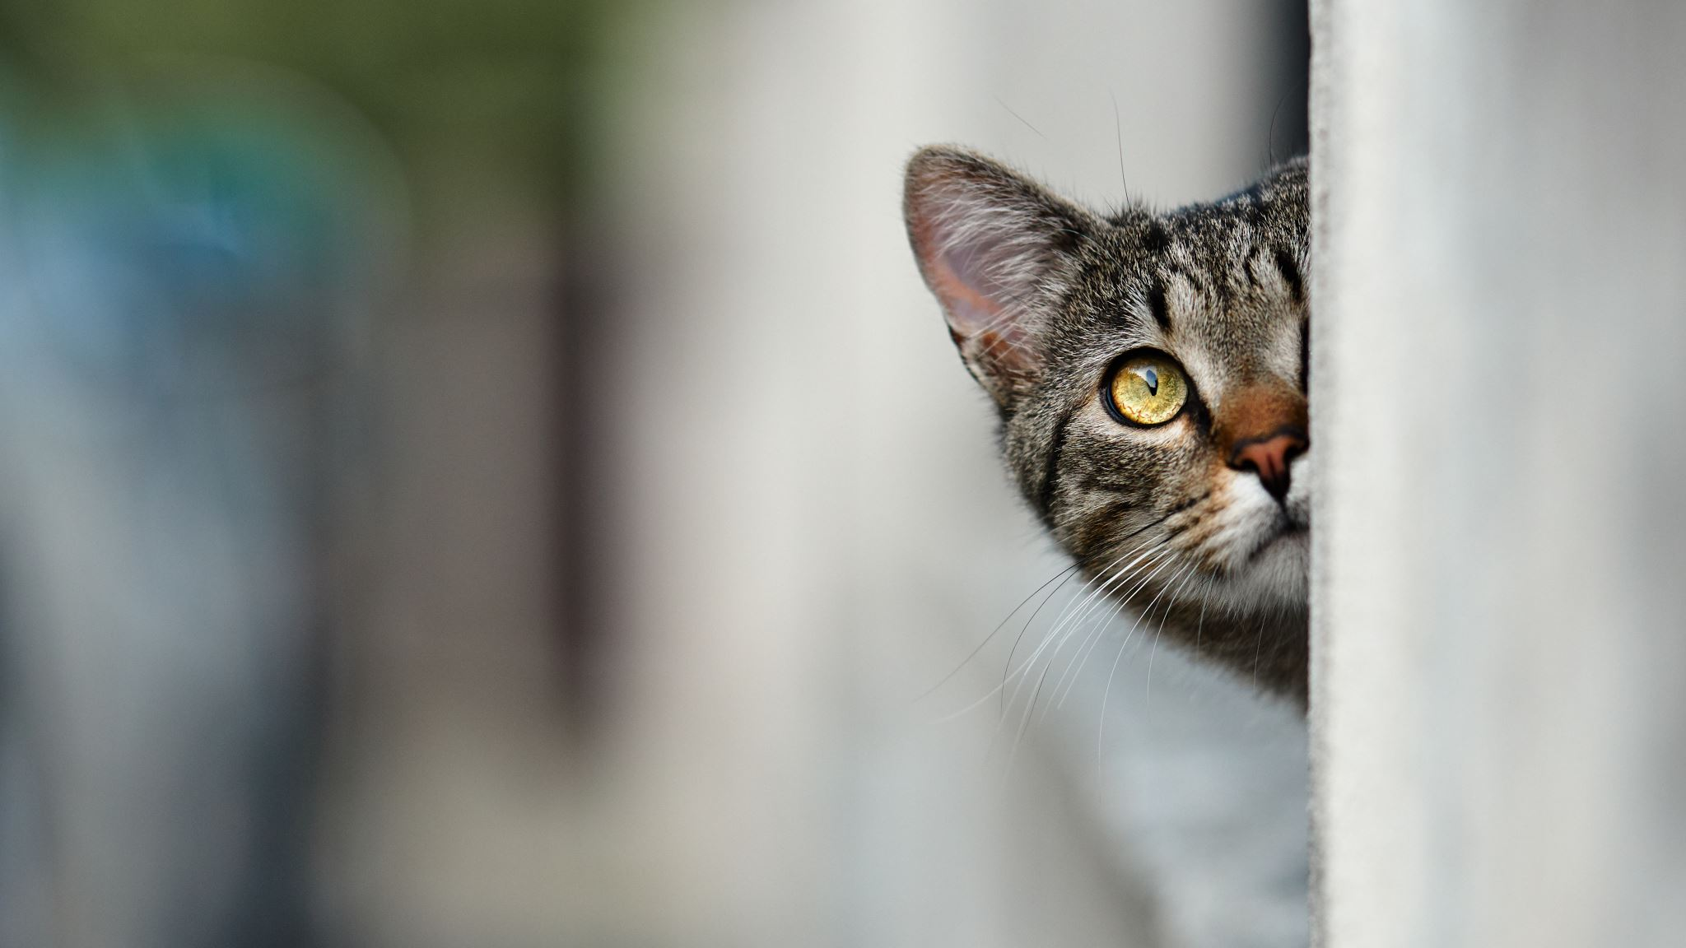
Peek (Front)
Look at the front of the queue without removing the element

Slide 18

Empty/isEmpty
Check to see if queue contains any elements

Slide 19

Full/isFull
Unable to accept new elements for enqueueing

Slide 20
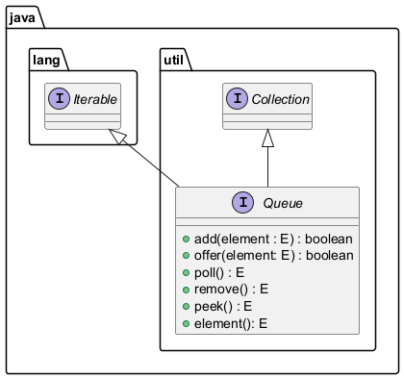
Java Queue Interface

Slide 21
Today
Introduction to Queues
Queue Characteristics
Queue Operations
Types of Queues
Queue Implementation
Applications of Queues and Practical Examples
Quiz

Slide 22
Types of Queues
Linear Queue (Basic)
Circular Queue (Try to limit wasted space)
Priority Queue (Elements are assigned a priority)
Operations: INSERT, MAX, REMOVE, REMOVEMAX, MODIFY, and SIZE
INSERT/MODIFY O(N) given need to find the correct spot in queue for insertion/change (if sorted)
MAX/REMOVEMAX O(N) if unsorted
Double Queue (Deque in Java, insert/remove at both ends)

Slide 23
Circular Queue Example with Array
0 1 2 3 4 5 6 7
Queue: 51, 81, 21, 87, 13, 46, 28, blank; Front = 0, Rear = 7, count = 7
After dequeue of 51 (51 is still in queue, but can be overwritten now, just make a copy)
Queue 51, 81, 21, 87, 13, 46, 28, blank; Front=1, Rear = 7, count = 6
After dequeue of 81
Queue 51, 81, 21, 87, 13, 46, 28, blank; Front=2, Rear = 7, count = 5
Enqueue 43 (wrap around of rear)
Queue 51, 81, 21, 87, 13, 46, 28, 43; Front=2, Rear = 0 count = 6 (so index 0 is effectively blank)
Enqueue 22, 91
Queue 22, 91, 21, 87, 13, 46, 28, 43; Front=2, Rear=2, count=8

Slide 24
Today
Introduction to Queues
Queue Characteristics
Queue Operations
Types of Queues
Queue Implementation
Applications of Queues and Practical Examples
Quiz

Slide 25
Implementation
Think: Buffer/Circular Buffer
Lower Level: Array (fixed) or Singly/Doubly Linked List (dynamic)
Alternative: Double Stack or Stack pointer & Base pointer

Slide 26
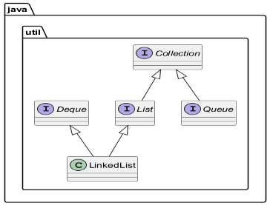
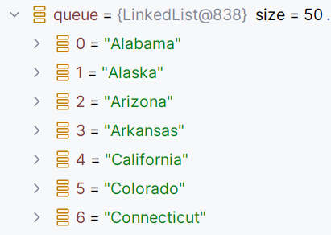
Java Implementation Classes – LinkedList Queue

Slide 27
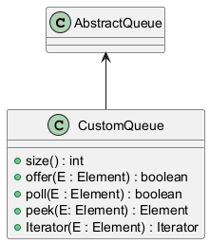
AbstractQueue
Class for the implementation of a minimally viable queue class
CustomQueue here overrides size, offer, pool, peek, and Iterator among other methods

Slide 28
Blocking Queue
Can’t use the regular queue in concurrent operations w/o providing some synchronization mechanism to access them
An alternative is to use a Blocking Queue
Array, LinkedList, Priority variants
Let’s see an example using ArrayBlockingQueue

Slide 29
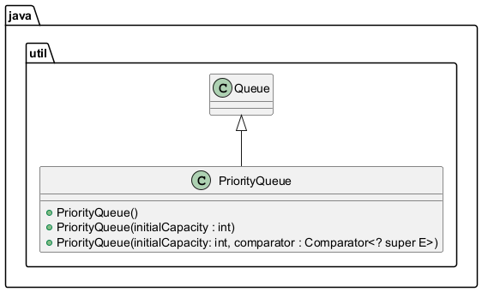
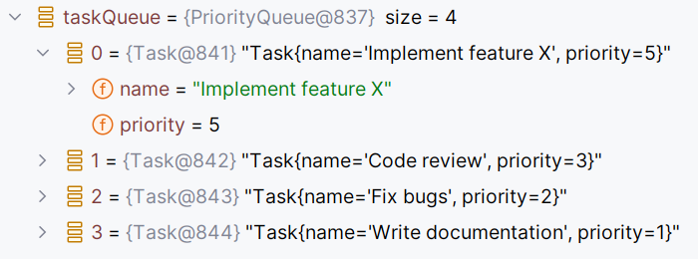
Java Implementation Classes – Priority Queue

Slide 30
Other Interesting Java Queues
DelayQueue – task scheduling, expiry caching, and rate limiting
SynchronousQueue – can’t enqueue an item until another item is dequeued on another thread
There are others…

Slide 31
Today
Introduction to Queues
Queue Characteristics
Queue Operations
Types of Queues
Queue Implementation
Applications of Queues and Practical Examples
Quiz

Slide 32

Scheduling
Operating Systems
Ready QUEUES – Use FIFO, Shortest Job Next, or Round Robin
Job QUEUES – Processes awaiting execution
Device QUEUES – Processes needing results of I/O operations

Slide 33

Print Job Management
Print Jobs go to Spool
FIFO ORDERING
JOBS held until device is ready
Prints jobs one at a time

Slide 34
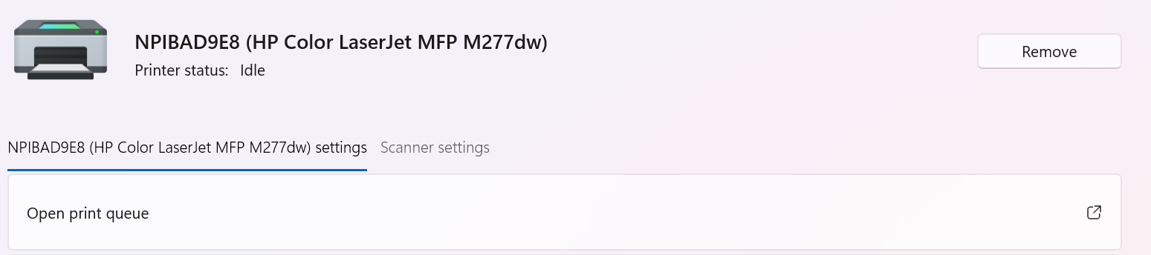
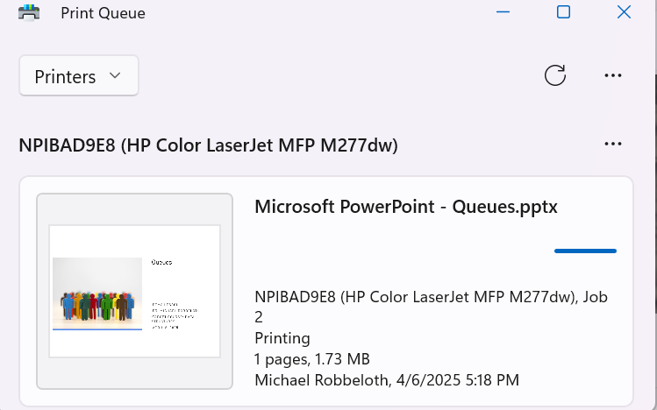

Slide 35
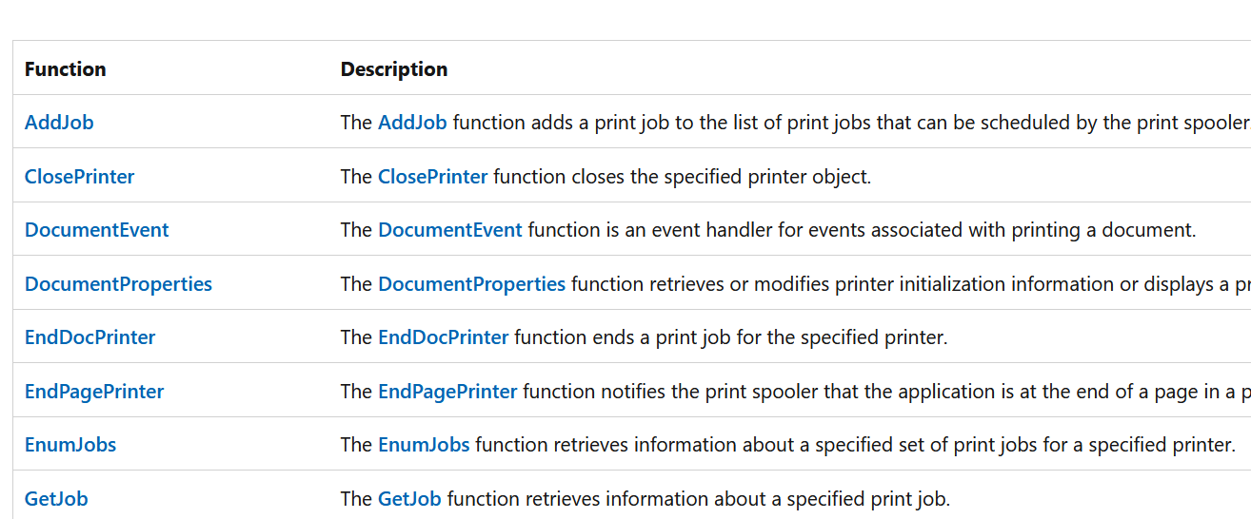
Win32 Print Spooler API Partial List

Slide 36

Breadth-First Search (BFS)
Graph Algorithms
Visits nodes level-by-level
Visit node, adds unvisited neighbors to the queue
Visits unvisited neighbors in FIFO order

Slide 37
Java Messaging Service (JMS)
Used in enterprise messaging (middleware component).
Create, send, receive, and read messages between endpoints
Common set of interfaces and semantics
Asynchronous communication between software components
Loosen coupling between components
Can use publish-subscribe (content hierarchy) or point-to-point (queues) messaging models
Requires a provider like Apache’s ActiveMQ (works with multiple programming languages)
In turn, non-Java/JMS systems can use proprietary APIs like CORBA from OMG to talk to JMS

Slide 38
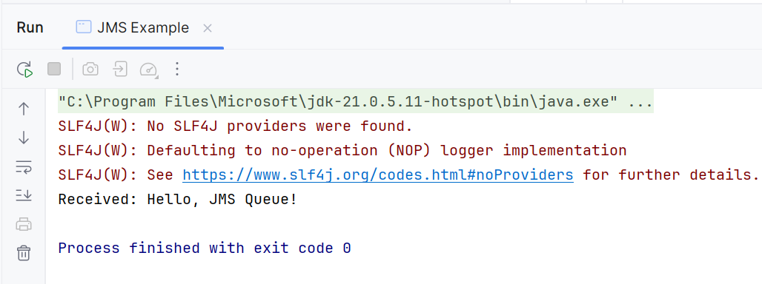
Java Messaging Service (JMS)

Slide 39
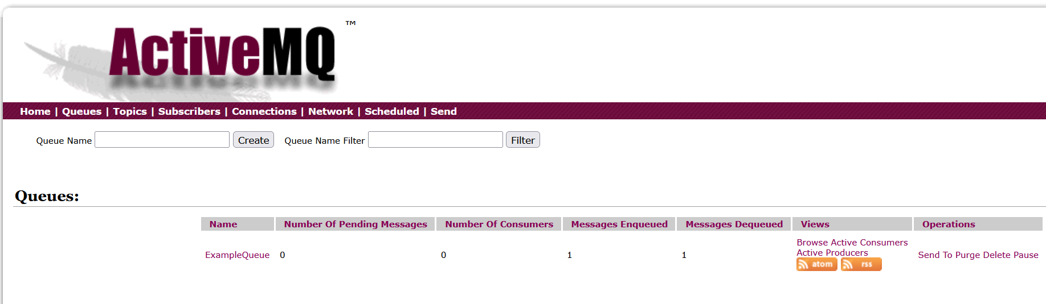
Java Messaging Service (JMS)

Slide 40
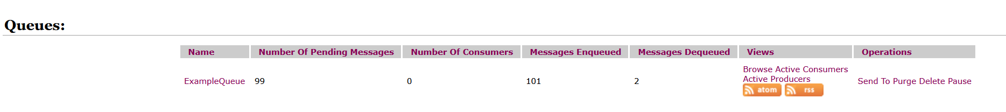
Java Messaging Service (JMS)

Slide 41
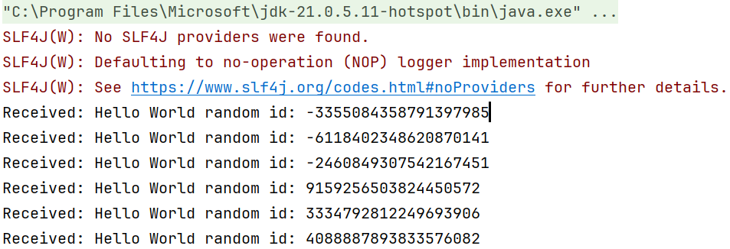
Java Messaging Service (JMS)

Slide 42

Java Messaging Service (JMS)

Slide 43
Today
Introduction to Queues
Queue Characteristics
Queue Operations
Types of Queues
Queue Implementation
Applications of Queues and Practical Examples
Quiz

Slide 44
Quiz is in a Kahoot…give me a minute

